Slide 1
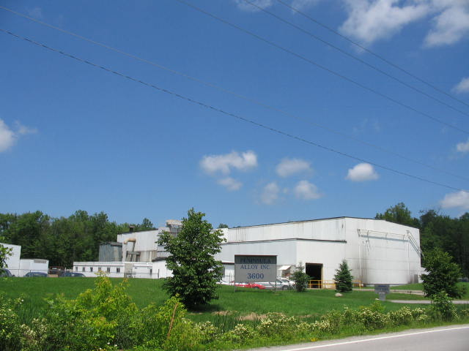
Peninsula Alloy
The Custom Steel Foundry of Choice

Slide 2
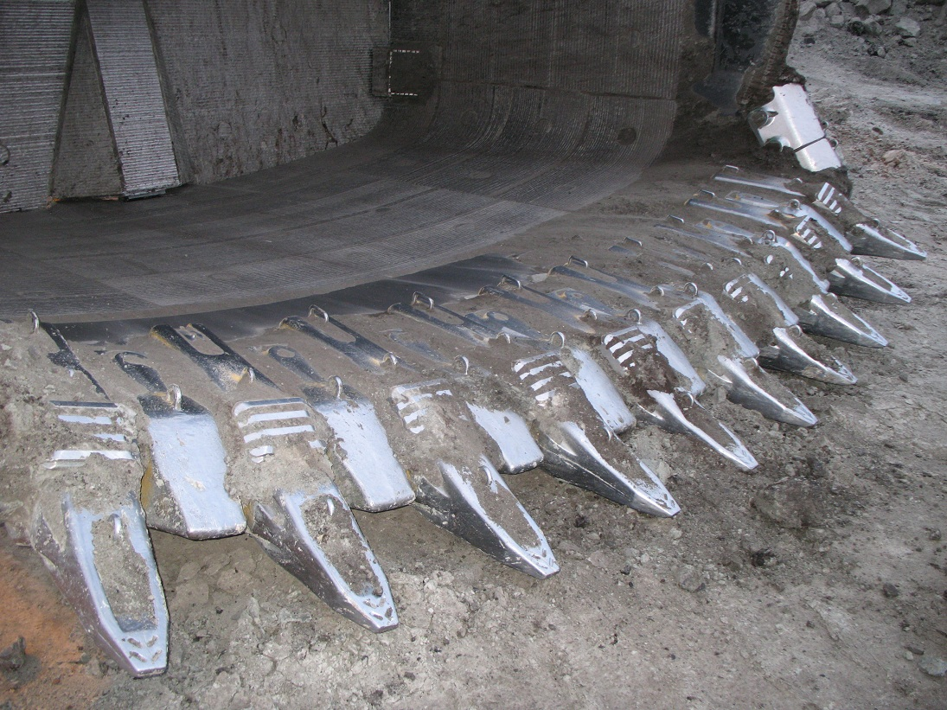
Mining

Slide 3
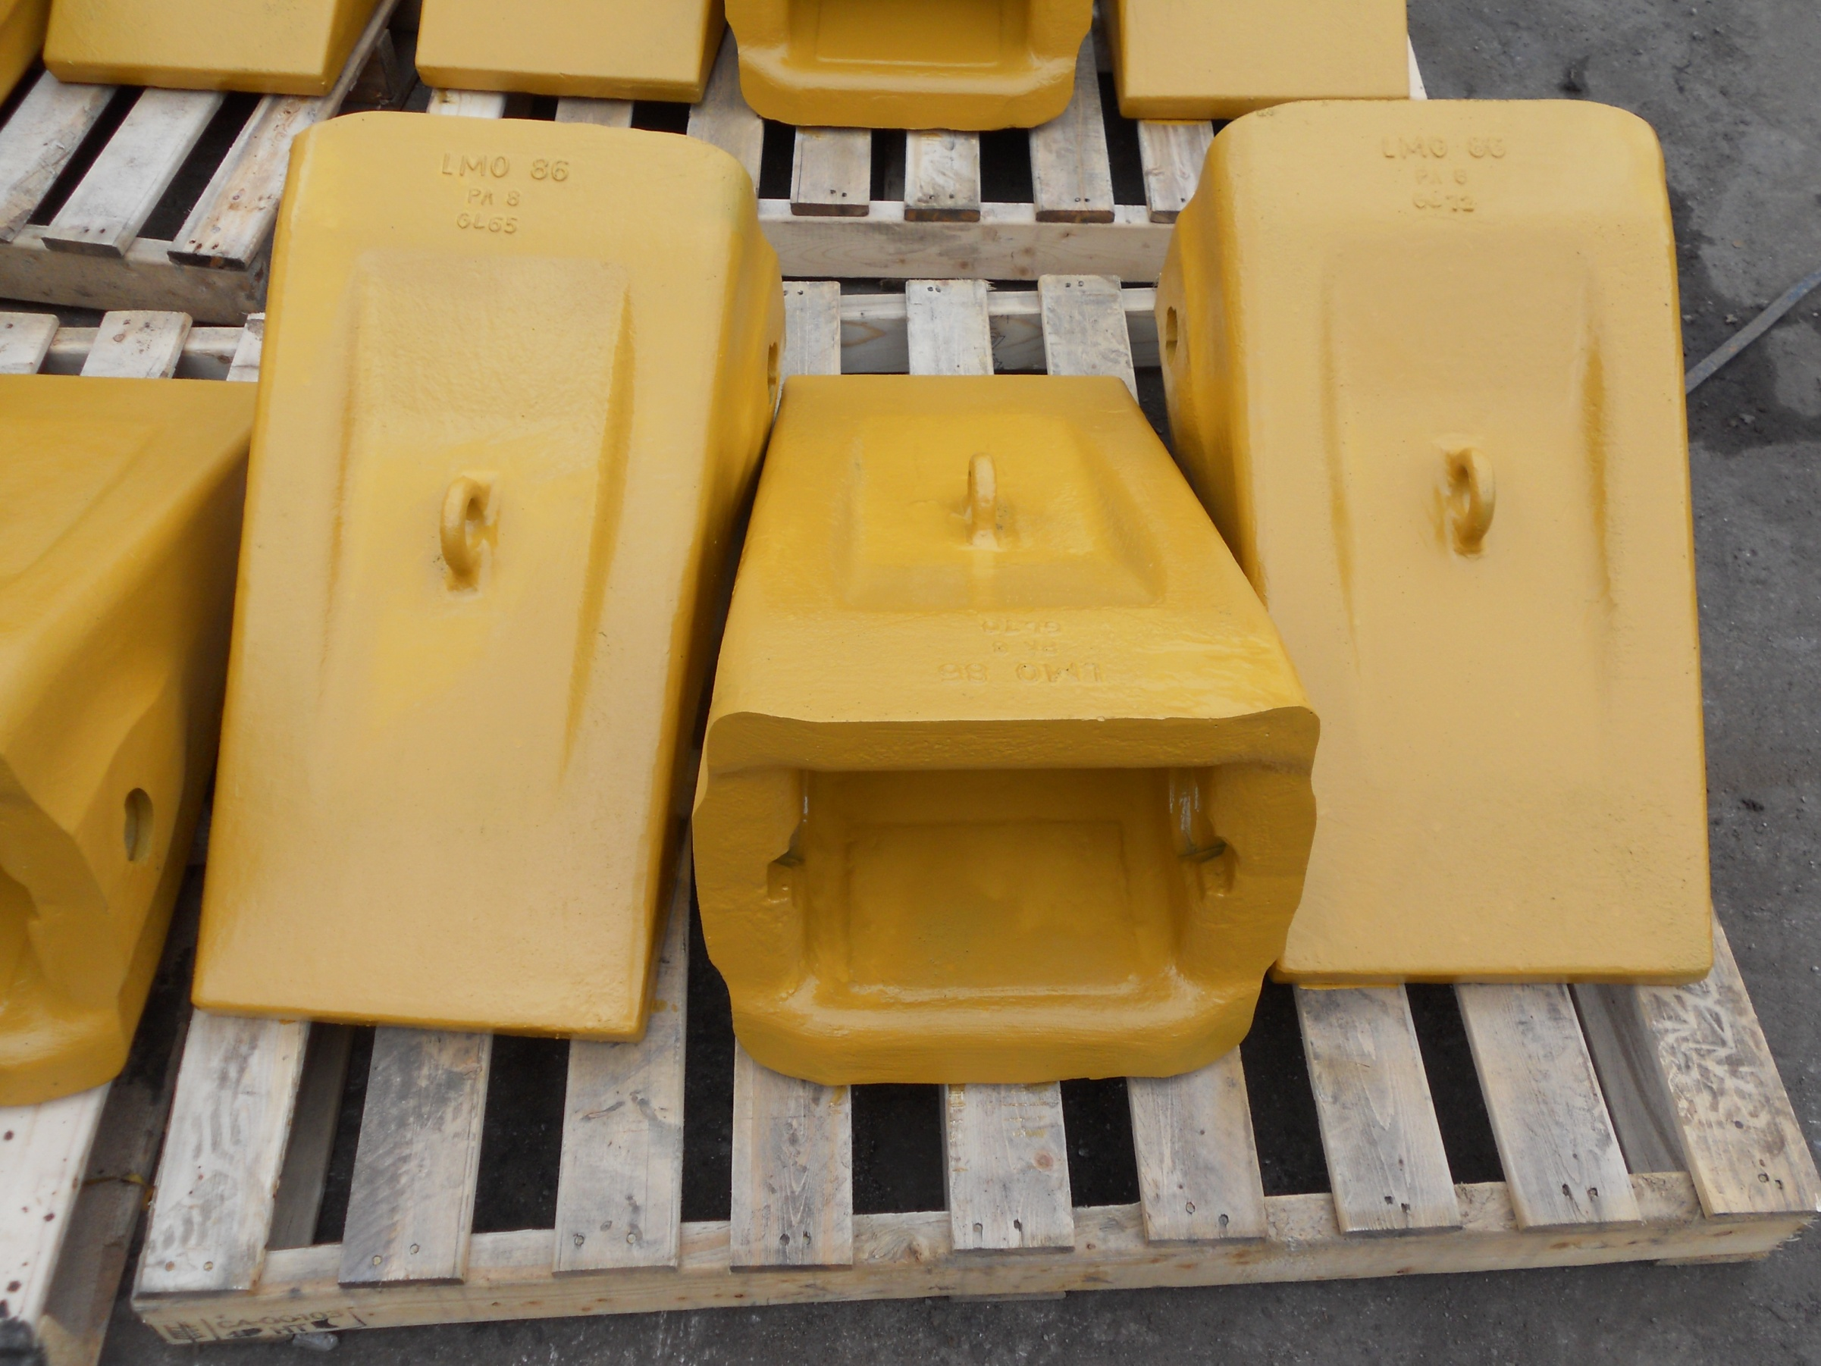
100 Yard Bucket Teeth

Slide 4
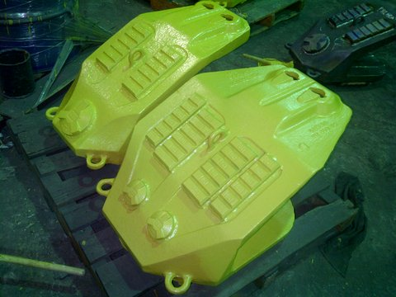
Lip Shrouds

Slide 5
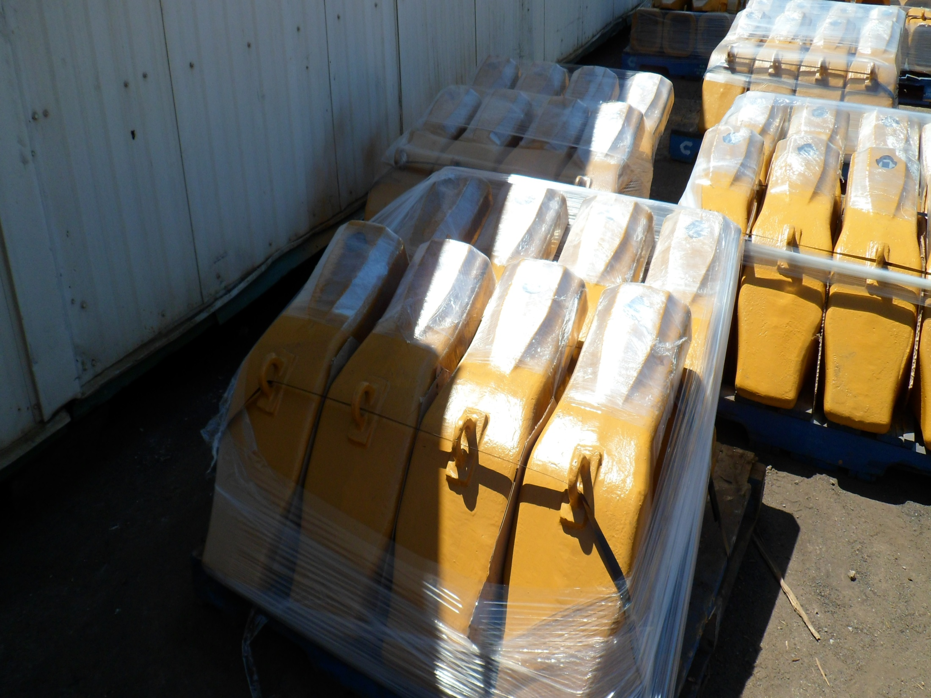
Tooth Adapters

Slide 6
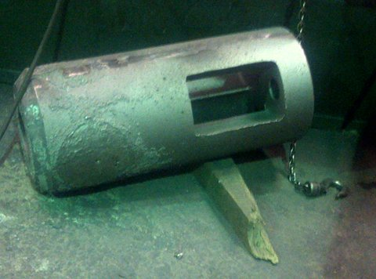
Drilling Stabilizers

Slide 7
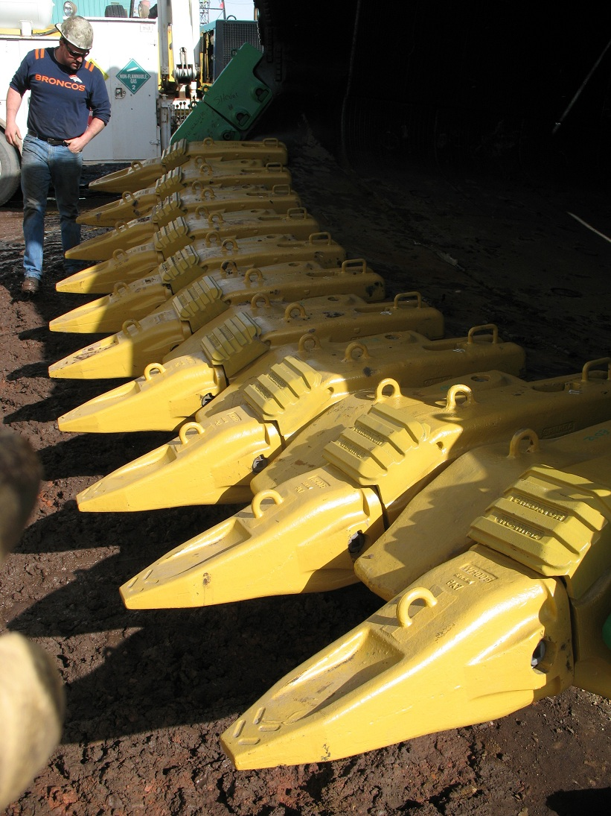
100 Yard Bucket Assembly

Slide 8
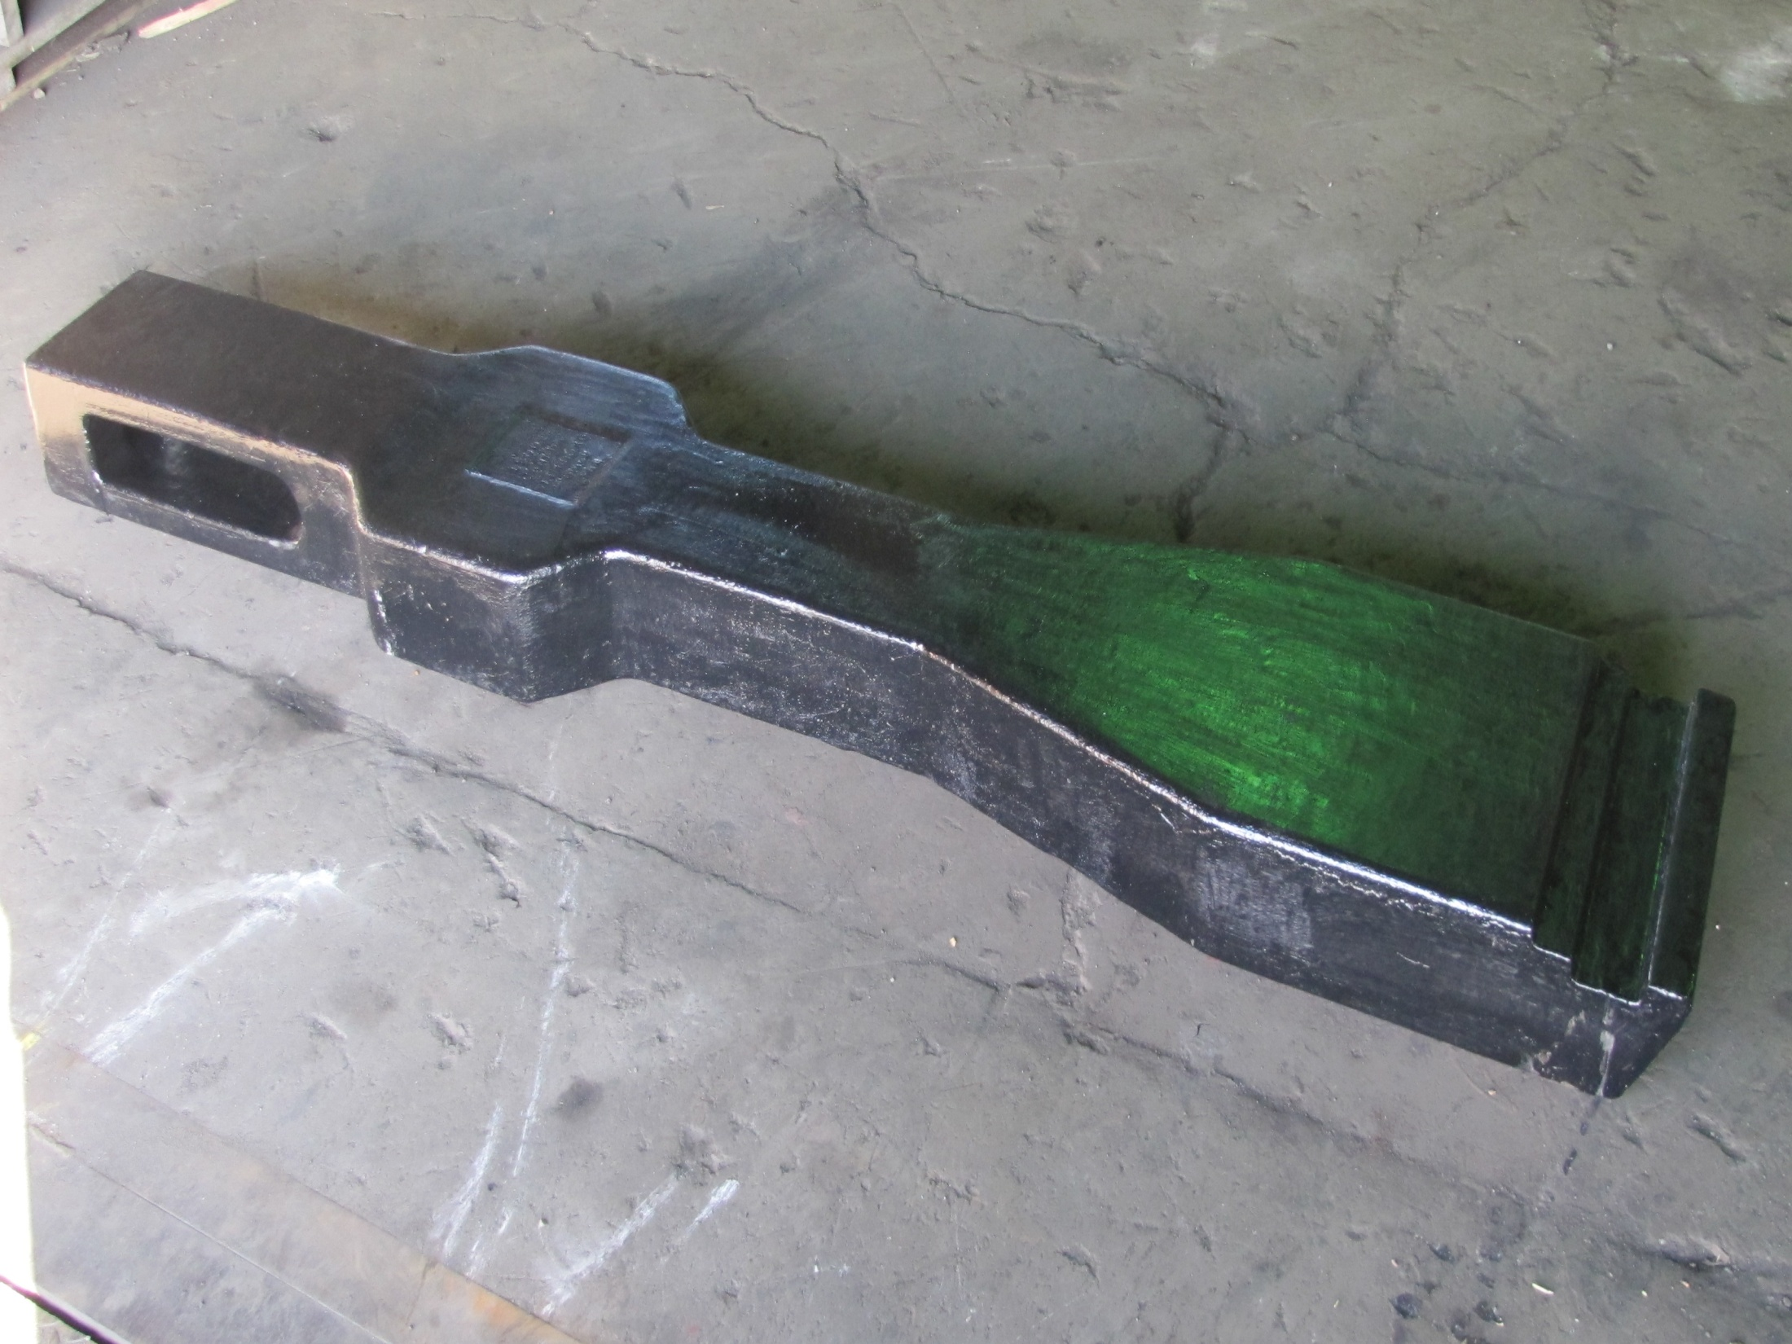
Manganese Latch Bar

Slide 9
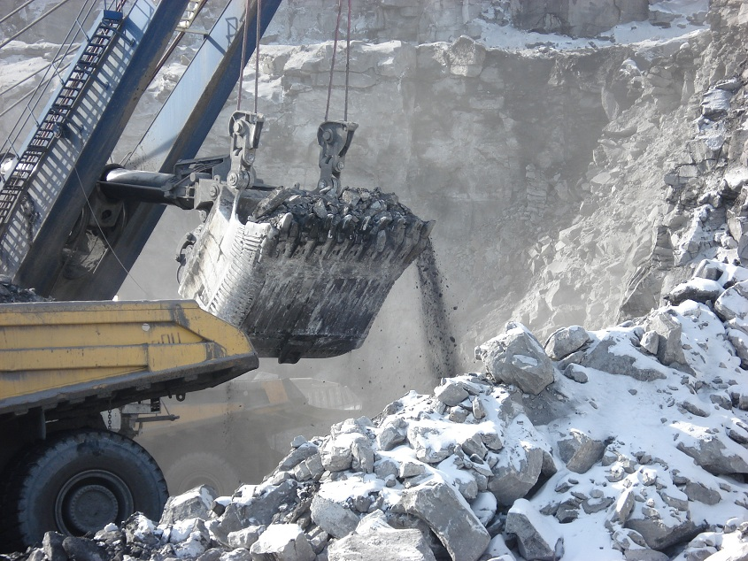
Penalloy Castings in Action

Slide 10
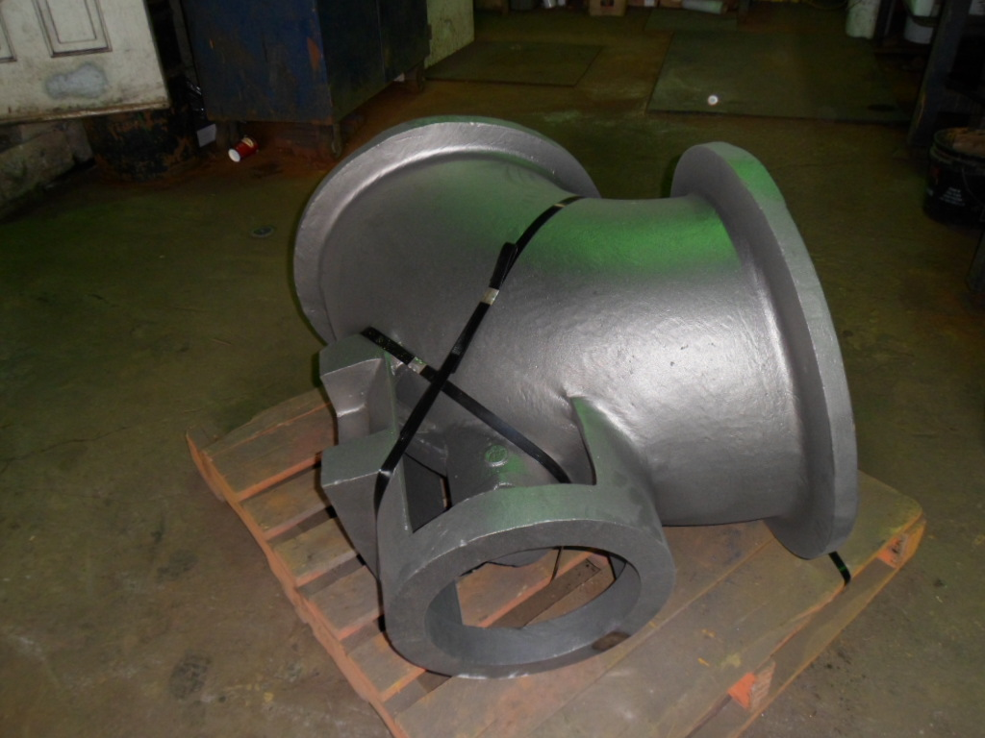
Oil and Gas

Slide 11
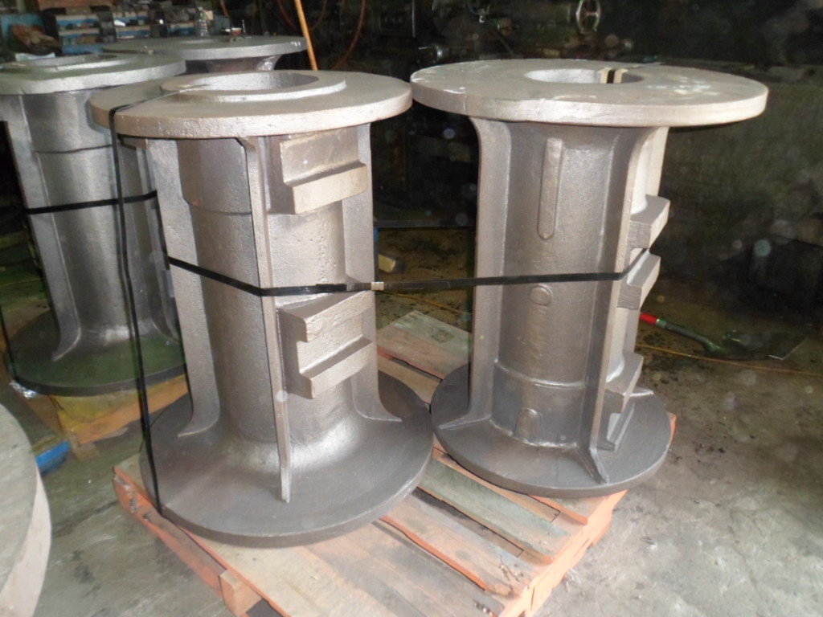
Pump Frames

Slide 12
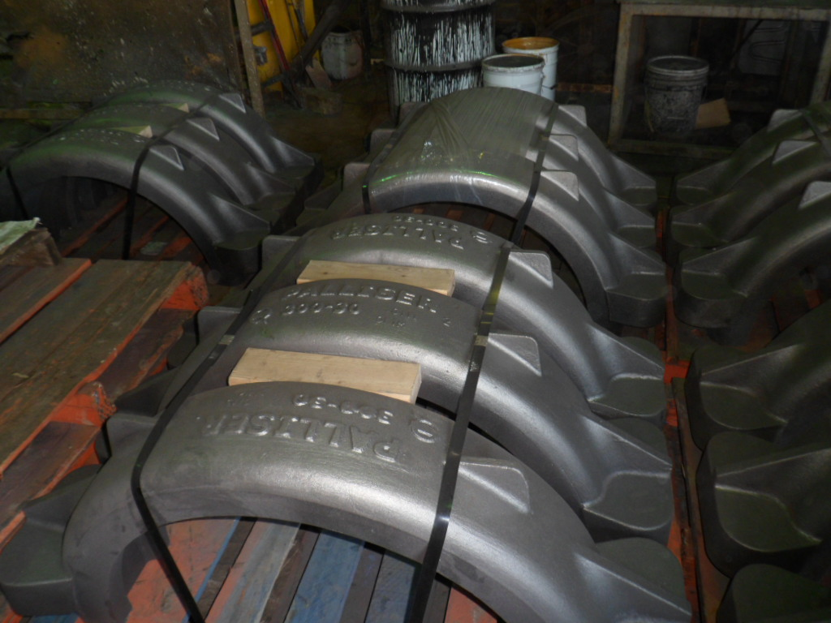
Pipe Line Clamps

Slide 13
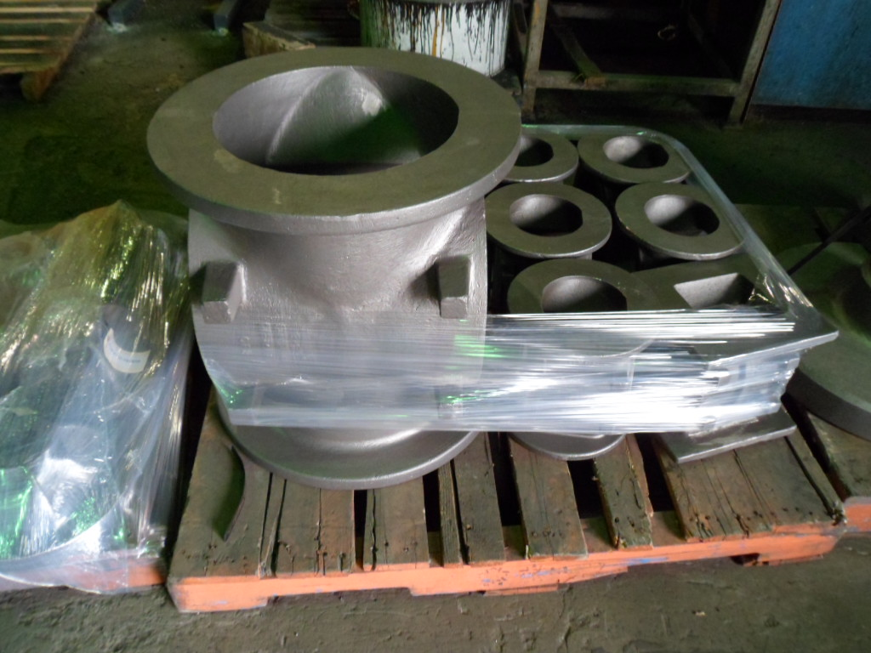
Valve Bodies

Slide 14
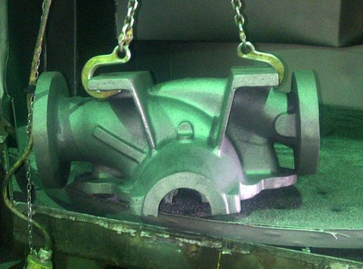
Pumps

Slide 15
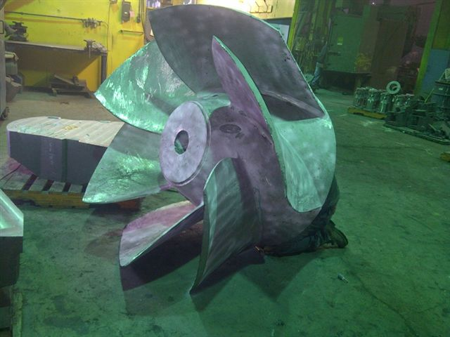
6 Vane Propeller

Slide 16
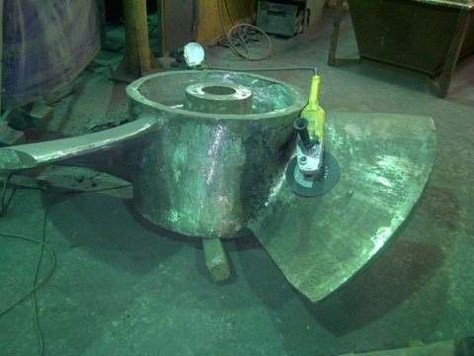
3 Vane Propeller

Slide 17
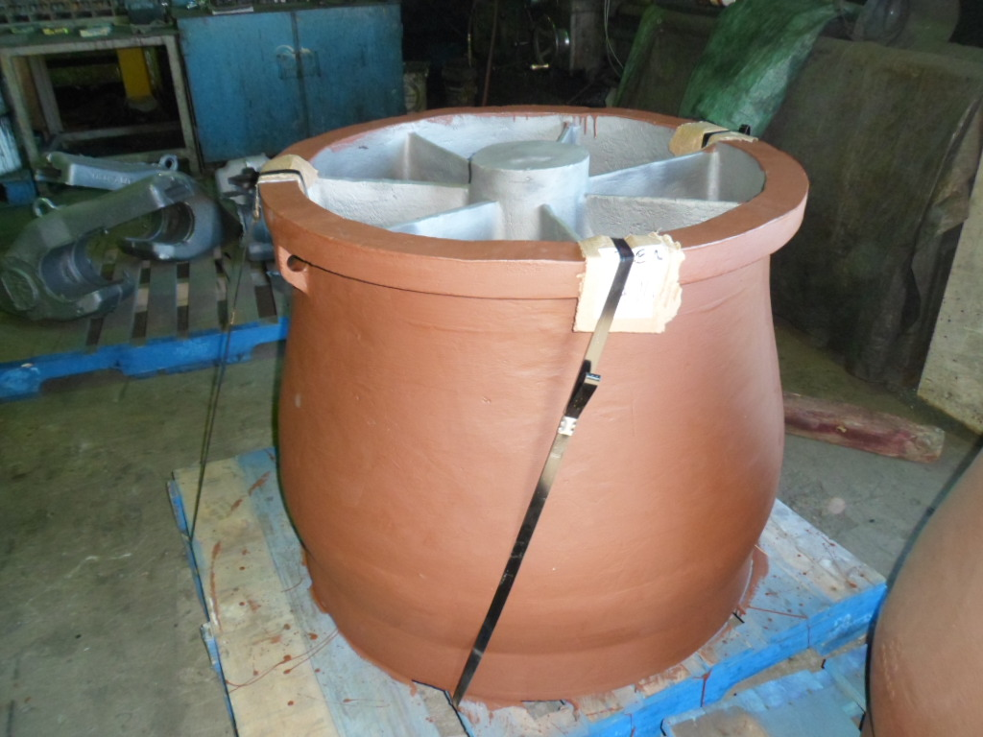
7 Vane Diffuser

Slide 18
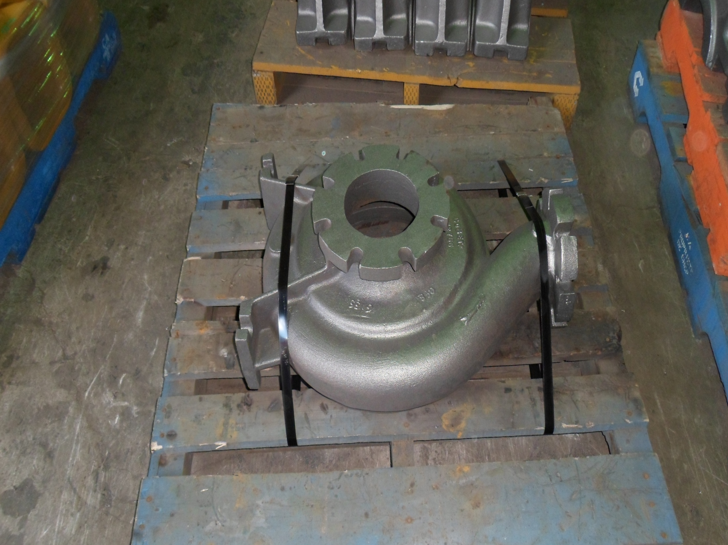
S
Stainless Pump Body

Slide 19
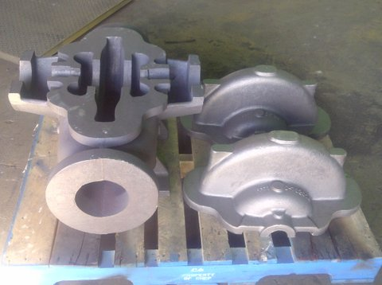
Pump Casings

Slide 20
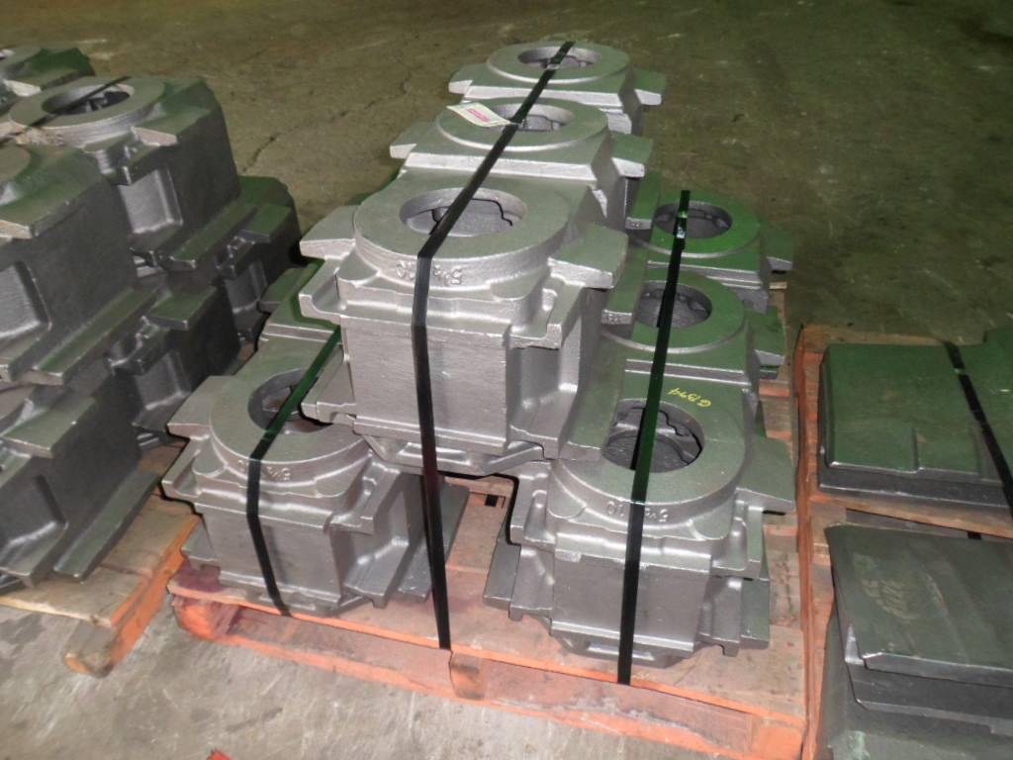
Locomotive Housings

Slide 21
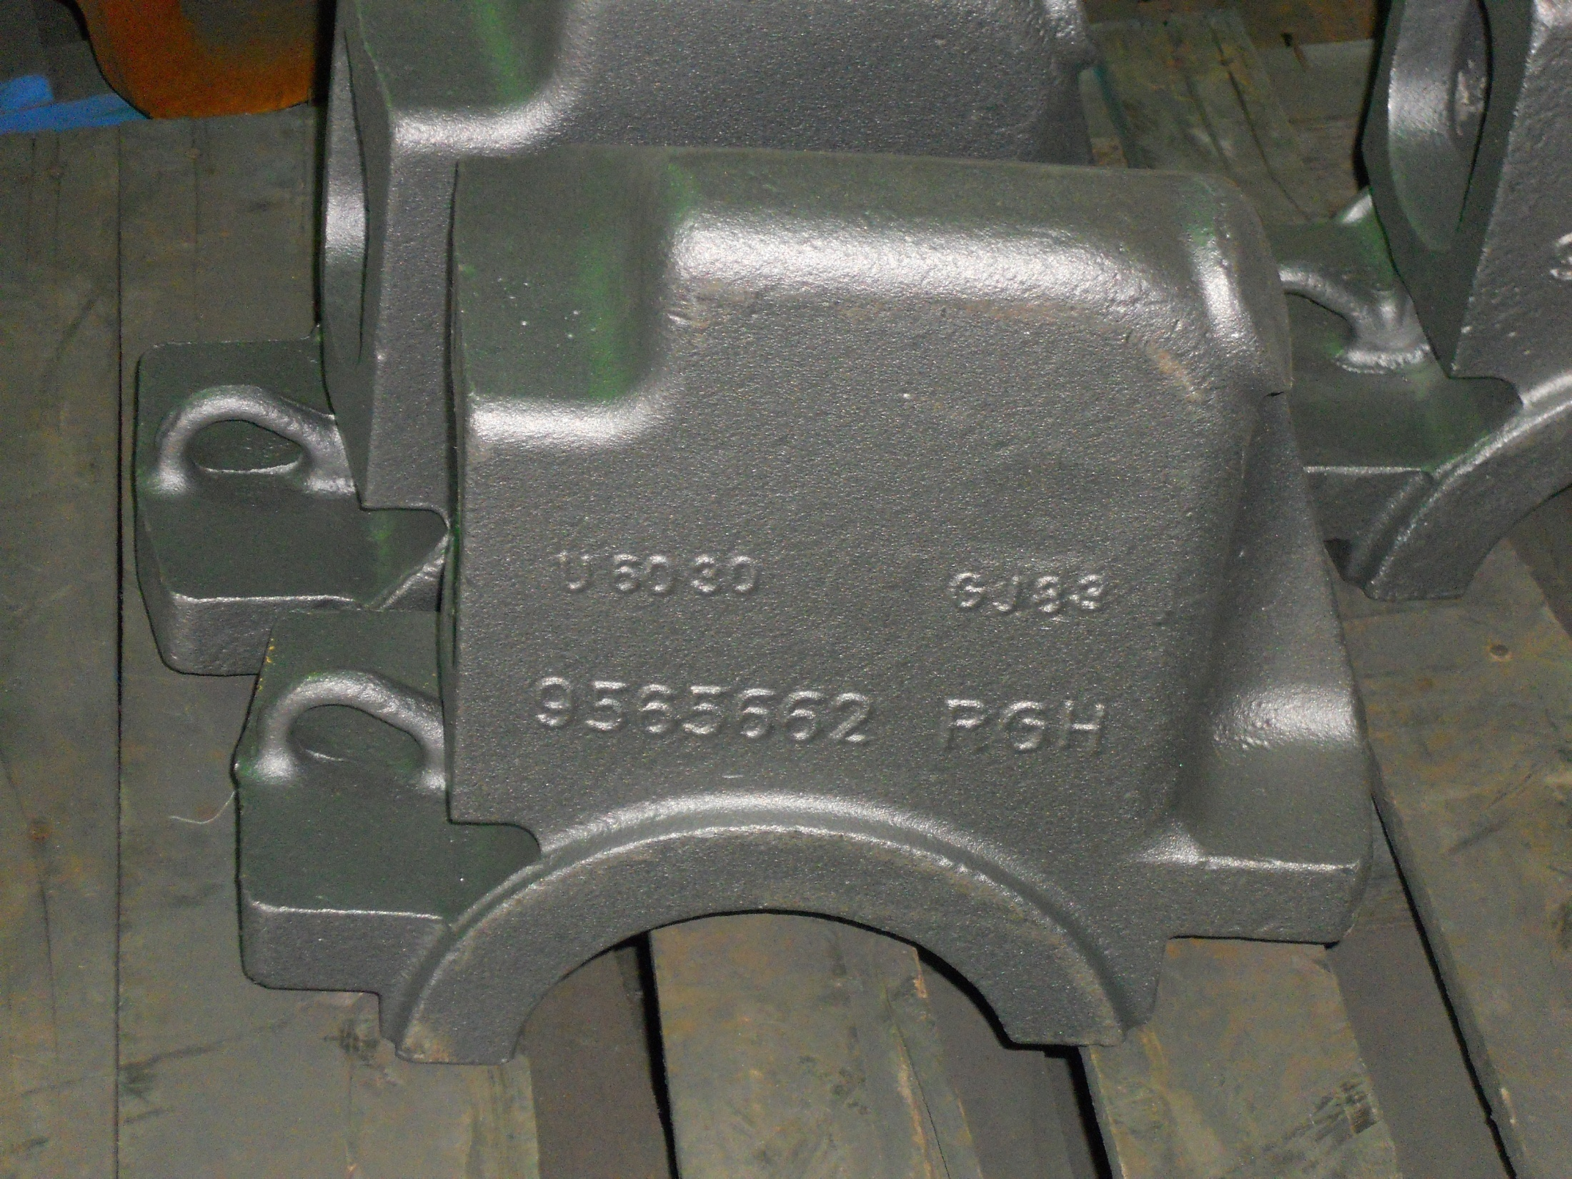
Locomotive Axle Caps

Slide 22
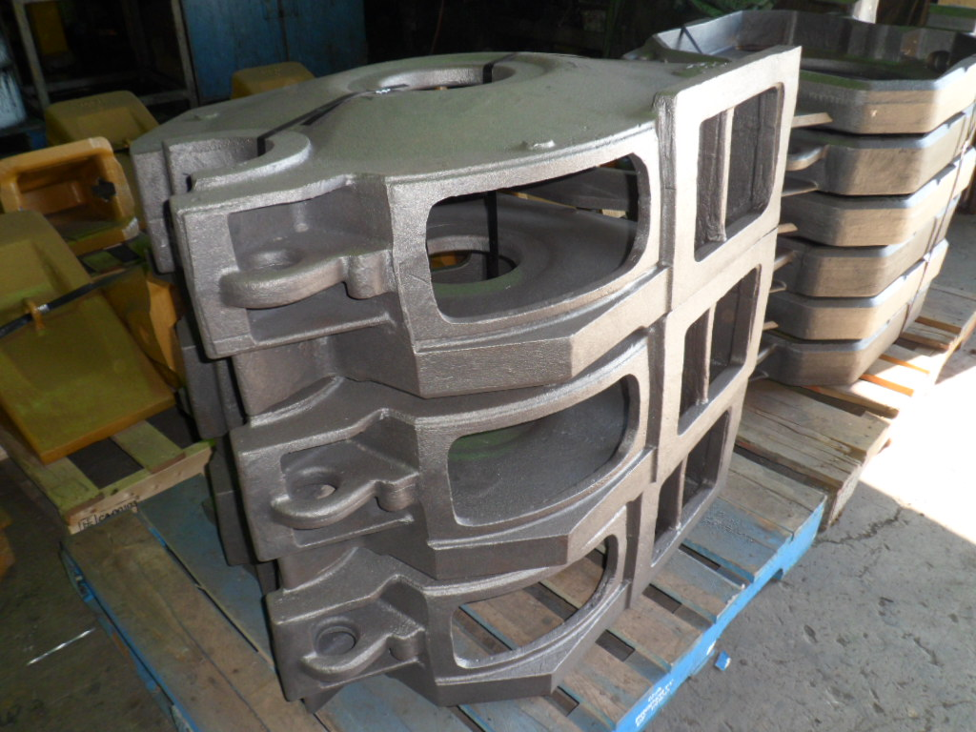
Locomotive Traction Motor Housings

